Slide 1

TEAM MOSS GREEN
Нина Петкова
Васил Арабаджиев
Тодор Атанасов
Кристиан Цаков
Кристиан Горанов

Slide 2
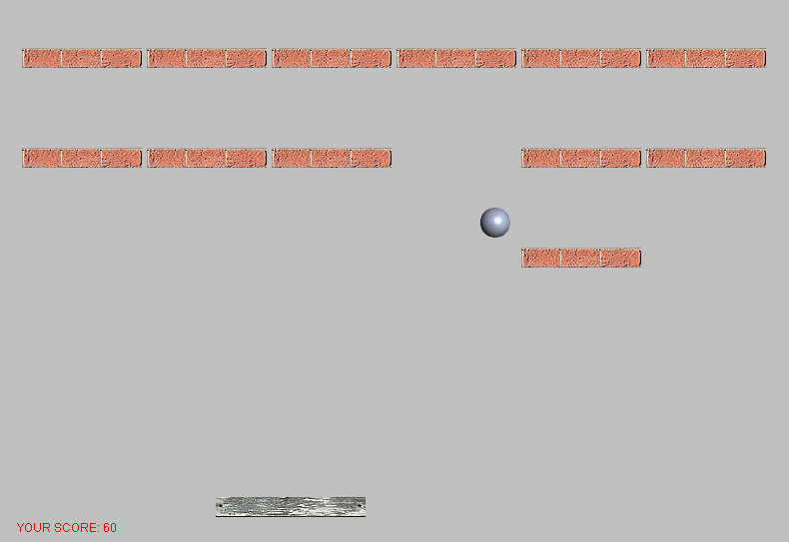
Bricks Breaker

Slide 3
The Game
Use left and right arrow keys to navigate the bat.
Destroy all the bricks
Don’t let the ball fall down

Slide 4
The Game
For every brick destroyed you take 10 points
After a brick is destroyed the speed of the ball increases

